Slide 1
Sona College of Technology
Department of CSE
U23CS704-Mini Project First Review
Date:
1

Slide 2
Aegis: Intelligent Child Chat Guardian
Name of the Supervisor Dr.A.C.Kaladevi. ME.MCA.Phd
Team No:
Team Details:
SAI RAJA RAJAN J K CSE C 4 TH YEAR (6178192102138)
SHALINI CSE C 4 TH YEAR (61782323102150)
Date:
U23CS704-Mini Project First Review
2

Slide 3
Problem Statement
Official Problem Statement-14
Child Exploitation & Grooming Pattern Detector for Social Media
Design a system to detect grooming patterns and child exploitation attempts on social media platforms using language modeling, chat monitoring, and behavioral indicators.
Protecting children in an increasingly connected world requires moving beyond outdated, reactive safety measures.
Date:
U23CS704-Mini Project First Review
3

Slide 4
Objective
•
To design and develop Aegis, a proactive, send-time chat safety system for children.
•
To implement an AI-based content classification engine capable of analyzing message context and intent rather than just isolated keywords.
•
To enable real-time interception of messages, blocking predatory content before delivery while allowing safe communication.
•
To provide context-aware Guardian Alerts that notify parents of threats without compromising the child's overall conversational privacy.
Date:
U23CS704-Mini Project First Review
4

Slide 5
Existing System
Current Approaches:
•
Keyword-Based Filtering: Relies on static lists of forbidden words (e.g., profanity, explicit terms).
•
Passive Monitoring / Logging: Records chat history for parents to review later.
•
Platform-Specific Reporting: Relies on users to flag inappropriate behavior after it occurs.
Drawbacks:
•
Easily bypassed using slang, intentional misspellings, or seemingly innocuous phrasing.
•
Fails to detect long-term grooming strategies or contextual threats.
•
Does not prevent the initial psychological harm, as intervention happens post-exposure.
Date:
U23CS704-Mini Project First Review
5

Slide 6
Research Gap
While significant research exists in Natural Language Processing (NLP) for general text classification and sentiment analysis, there is a notable gap in applying these advanced contextual AI models specifically for real-time, pre-delivery intervention in youth chat environments. Existing solutions either lack the nuanced understanding required to detect subtle grooming behaviors, or they operate retroactively, failing to act as a preventative shield at the exact moment of transmission.
Date:
U23CS704-Mini Project First Review
6

Slide 7
Novelty
•
Send-Time Interception: The system shifts from passive auditing to active, real-time intervention. Messages are evaluated and blocked before they reach the recipient's screen, preventing exposure entirely.
•
Intent vs. Keywords: Utilizing AI to analyze the underlying psychological intent and context of the conversation, effectively identifying manipulation tactics that evade simple keyword filters.
•
Privacy-Preserving Alerts: Alerts parents only when necessary, providing contextual reasoning for blocks without requiring constant surveillance of harmless chat logs.
Date:
U23CS704-Mini Project First Review
7

Slide 8
Proposed Methodology
•
Data Collection & Preprocessing: Gather and anonymize datasets containing examples of both safe peer-to-peer chat and known predatory/grooming interactions.
•
Model Selection & Training: Utilize NLP models (e.g., BERT, RoBERTa) fine-tuned specifically for intent classification and grooming detection.
•
Message Interception Pipeline: Develop a middleware component that temporarily holds outgoing messages from the chat interface.
•
Contextual Evaluation: Pass intercepted messages through the AI model, which evaluates the current message alongside recent conversation history to generate a risk score.
•
Decision Engine: Implement logic to allow delivery of safe messages or trigger a block and alert mechanism if the risk score exceeds defined thresholds.
Date:
U23CS704-Mini Project First Review
8

Slide 9
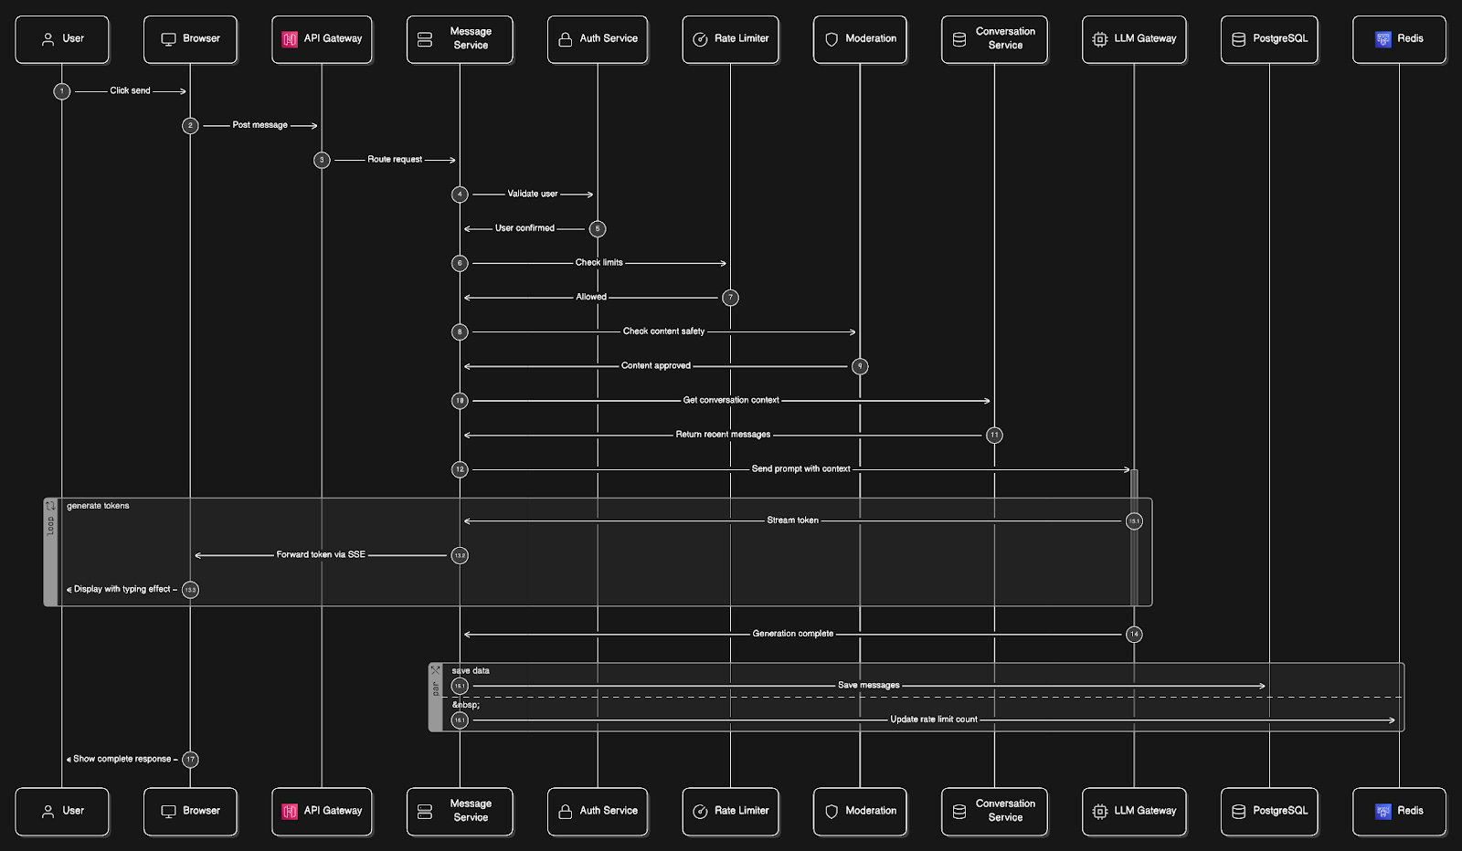

Proposed-Workflow Diagram
Data Flow: Sender → Intercept Buffer → AI Context Classifier → Decision (Deliver/Block) → Receiver/Guardian Alert
[ Insert Architecture / Workflow Diagram Here ]
Date:
U23CS704-Mini Project First Review
9

Slide 10
Tools and Technology
Programming Languages:
•
Python (Backend/AI), JavaScript (Frontend/Chat Interface), Flutter
Framework:
•
Flask/FastAPI, TensorFlow/PyTorch, React
Tools:
•
VS Code, Git/GitHub, Postman (API Testing)
Dataset:
•
PAN12 Sexual Predator Identification Dataset (or similar cyberbullying datasets)
Date:
U23CS704-Mini Project First Review
10

Slide 11
References
1. For NLP Detection – Detoxify Lightweight, runs locally, perfect for real-time classification https://github.com/unitaryai/detoxify
2. For Send-Time Intercept – FastAPI WebSockets To catch message before it’s delivered https://github.com/tiangolo/fastapi/tree/master/examples/websockets
3. For Training Data – PAN12 Grooming Dataset Labeled grooming conversations to train/fine-tune your model Search on Kaggle: PAN12 Online Grooming
4. For Demo Chat UI – React Native Gifted Chat Ready chat UI with socket support to show Aegis in action https://github.com/FaridSafi/react-native-gifted-chat
Date:
U23CS704-Mini Project First Review
11

Slide 12
Queries????
Date:
U23CS704-Mini Project First Review
12

Slide 13
Thank you
Date:
U23CS704-Mini Project First Review
13

